Slide 1


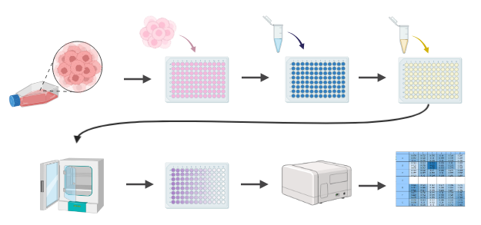
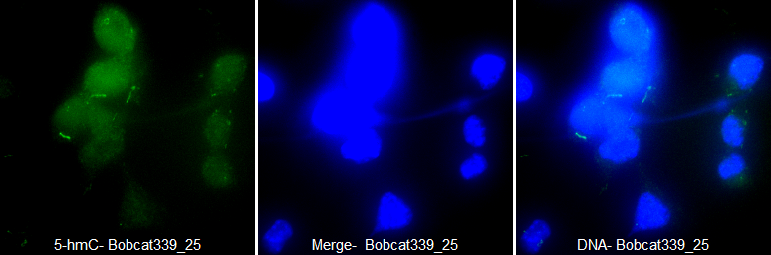
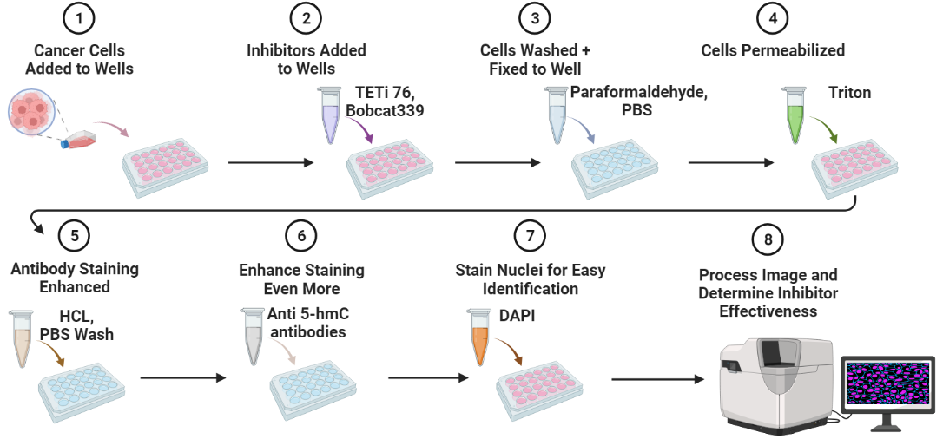
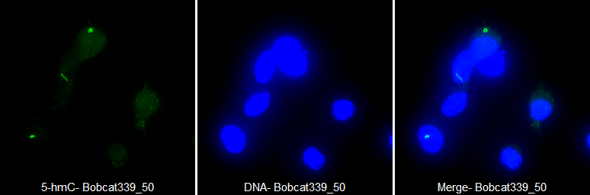
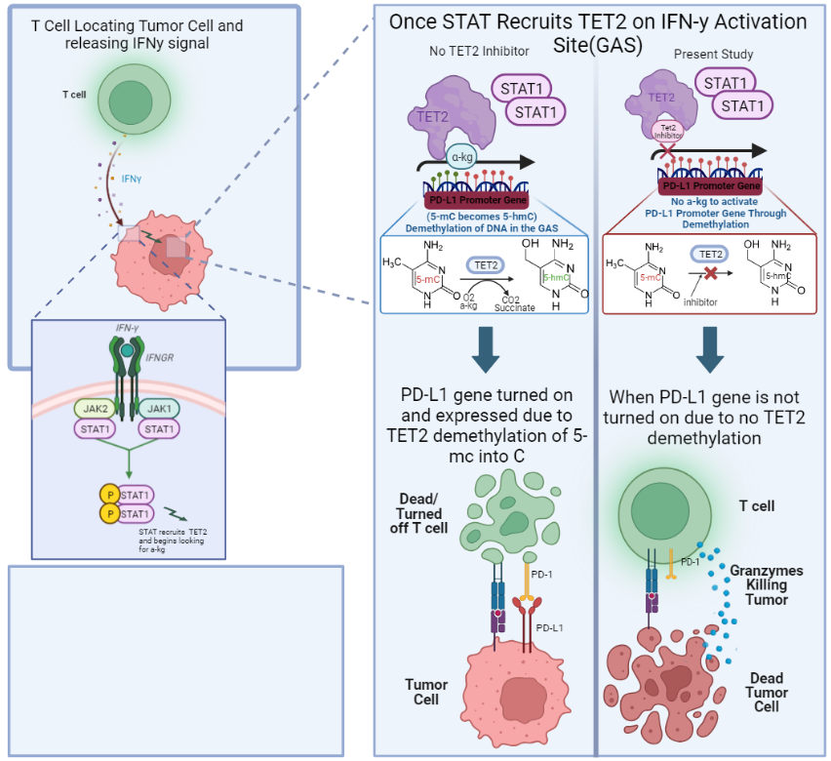
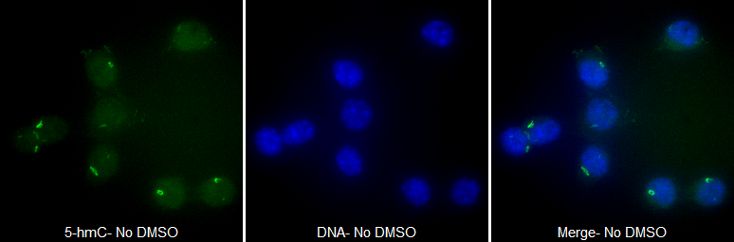
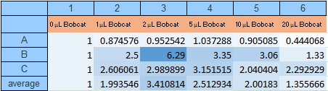
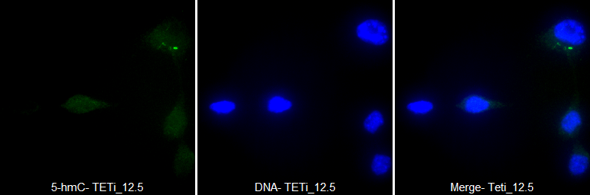

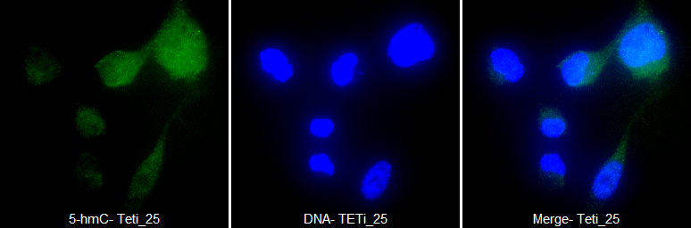

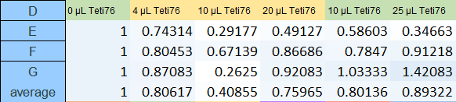
Evaluating Small Molecule Inhibition of TET2 to Overcome Adaptive Resistance to Radiation
Samuel J. Frausto, Sera Averbek, Stephen J. Kron
The University of Chicago Biological Sciences Department of Cellular Genetics and Microbiology
ABSTRACT
MATERIALS AND METHODS
Bobcat339 Results With 25µM (top) and 50 µM (bottom) (M2)
The efficacy of radiation seems to be dependent upon the immune system's ability to induce an anti-tumor response thereafter. Adaptive resistance has shown to get in the way of this response, and PD-L1 expression has been identified as a target for maximizing radiation therapy results. The present study is dedicated towards getting past current TET2 inhibition limits by using the small molecules, TETi76 and Bobcat339, as alpha-ketoglutarate competitors to inhibit TET2 demethylation. To evaluate the effectiveness of this targeting, we first conducted an MTT assay to determine optimal inhibitor concentrations. Next, immunofluorescence staining of 5-hmC showed that small molecule inhibitors of TET2 are worth studying further. Throughout the entire project, we contemplated the functionality of using artificial intelligence as a research tool. This resulted in a subproject involving proteomics that helped evaluate how useful(and truthful) AI can be.
First, using an MTT assay, we assessed a wide variety of concentrations of both TETi76 as well as Bobcat339 to determine how much of each molecule to use for the true experiment. We tested the anti-proliferation rates of the respective inhibitors using a CT-26 Cell line. (M1)
CT-26 Cell Line
Plate Tumor Cells
Add Inhibitor at Variety of μmol Concentrations
Add MTT Solution
5-hmC
DNA
5-hmC/DNA Merge
Incubate
Use SynergyNeo Device to Obtain Absorbance Value
Next, we took advantage of the 5hmC increase after IFN- γ stimulation. We used immunofluorescence staining of 5-hmC to determine effectiveness of both inhibitors. The concentrations we used were determined in the method above. Stained foci showed true demethylation of 5-mC into 5-hmC. (M2)
BACKGROUND AND OBJECTIVES
RESULTS
Summary + Future Directions
Determining Optimal Bobcat339µM (M1)
Control Results with only CT-26 Cells (top) and DMSO (bottom) (M2)
12.5/25 µM of TETi76 and 25/50 µM of Bobcat339 were shown to be optimal in M1
The control appears to show considerably higher 5-hmC levels than both inhibitors
TETi76 showed very small 5-hmC levels which indicates that demethylation was effectively interrupted
Small molecule approaches in targeting TET2 inhibition are shown to be worth looking into more, as 5-hmC levels appear to be lowered from inhibitors
We would like to run this experiment again, and confirm the results
We are looking to identify more small molecules that can act as TET2 inhibitors, specifically other alpha-ketoglutarate competitors
5-hmC
DNA
5-hmC/DNA Merge
5-hmC
DNA
5-hmC/DNA Merge
ACKNOWLEDGEMENTS
My immense appreciation goes out to everyone who made this research possible:
Stephen Kron M.D. Ph.D..(Principal Investigator) and everyone I interacted with in the Kron Lab
Sera Averbek Ph.D., my Research Supervisor/Mentor
Don Wolfgeher, the proteomics expert
Megan Mekinda Ph.D., Basia Galinski PhD., and Michelle Domecki
The University of Chicago Cancer Center and Microscope Core
Objectives:
-Determine optimal concentrations of small molecule TET2 inhibitors
-Measure effectiveness of small molecules TETi76 and Bobcat339 as alpha-ketoglutarate competitors to block function of TET2 Demethylation
Determining Optimal TETi76µM (M1)
TETi76 Results With 12.5µM (top) and 25 µM (bottom) (M2)
5-hmC
DNA
5-hmC/DNA Merge
USE OF ChatGPT-4 IN RESEARCH + PROTEOMICS
CITATIONS
As artificial intelligence(AI) is a relatively new and rapidly developing technology, we were unsure if it’s use would be beneficial or harmful in the present study. To test this, we presented both a proteomics expert as well as an amateur with identical protein sequencing projects, allowing the former to strictly use traditional methods, and the latter to strictly use OpenAI’s GPT-4. Scan the QR code to see the functions/limitations of AI as well as it’s implementations in the present study.
1. Platanias, L. (2005). Mechanisms of type-I- and type-II-interferon-mediated signalling. Nat Rev Immunol, 5, 375–386.
2. Doi, T., Ishikawa, T., Okayama, T., Oka, K., Mizushima, K., Yasuda, T., ... Itoh, Y. (2017). The JAK/STAT pathway is involved in the upregulation of PD-L1 expression in pancreatic cancer cell lines. Oncology Reports, 37, 1545-1554.
3. Rasmussen, K. D., & Helin, K. (2016). Role of TET enzymes in DNA methylation, development, and cancer. Genes Dev, 30(7), 733-750. doi: 10.1101/gad.276568.115.
4. Xu, Y.-P., Lv, L., Liu, Y., Smith, M. D., Li, W.-C., Tan, X.-M. (2019). Tumor suppressor TET2 promotes cancer immunity and immunotherapy efficacy. J Clin Invest, 129, 4316-4331.
5. Chua, G. N. L., Wassarman, K. L., Sun, H., Alp, J. A., Jarczyk, E. I., Kuzio, N. J., Bennett, M. J., Malachowsky, B. G., Kruse, M., & Kennedy, A. J. (2019). Cytosine-Based TET Enzyme Inhibitors. ACS Med Chem Lett, 10(2), 180-185. doi: 10.1021/acsmedchemlett.8b00474. PMID: 30783500; PMCID: PMC6378777.
6. DNA Reactome. (2023). TET1,2,3 and TDG demethylate. Retrieved June 20, 2023, from https://reactome.org/content/detail/R-HSA-69306
7. All images were created using Biorender.com and all image analysis was done through Image J
ResearcHStart is funded through philanthropic support from Debra and Ira Cohen, Kim Duchossois, and other generous donors.

